Slide 1
CS 484
Introduction to Machine Learning
Week 13, April 15, 2021
Spring Semester 2021

Slide 2
Week 13 Agenda: Ensemble Learning
Bootstrapping
Bagging
Boosting

Slide 3
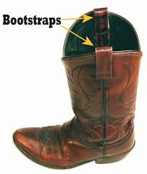
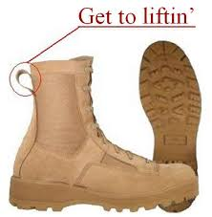

Bootstrap, the Dictionary Meaning
Bootstrap
(noun) A looped strap sewed at the side or the rear top of a boot to help in pulling it on
(Idiom) To pull oneself up by one's bootstraps – To succeed only on one’s effort or abilities, despite limited resources, or to function independently without outside assistance

Slide 4
A General Statistical Problem
Observe a random sample of independently and identically distributed (i.i.d.) observations $X=\left(X_{1},…,X_{n}\right)$ from a probability distribution F
Observe a random sample of independently and identically distributed (i.i.d.) observations 𝐗=(𝑋_1,…,𝑋_𝑛 ) from a probability distribution F
Compute a statistic $s\left(X\right)$ based on the observed sample $X$
Compute a statistic 𝑠(𝐗) based on the observed sample 𝐗
Estimate the sampling distribution, the 95% confidence interval, or the standard error of the statistic $s\left(X\right)$
Estimate the sampling distribution, the 95% confidence interval, or the standard error of the statistic 𝑠(𝐗)

Slide 5
The Typical Textbook Problem
The probability distribution is $F\sim N\left(μ,σ^{2}\right)$ F is the Normal distribution with mean $μ$ and variance $σ^{2}$
The probability distribution is 𝐹~𝑁(𝜇,𝜎^2 ) F is the Normal distribution with mean 𝜇 and variance 𝜎^2
The statistic $s\left(X\right)$ is the sample mean $\overline{X}=\frac{1}{n}\sum_{i=1}^{n}{X_{i}}$
The statistic 𝑠(𝐗) is the sample mean 𝑋 ̅=1/𝑛 ∑2_(𝑖=1)^𝑛▒𝑋_𝑖
The sampling distribution of mean $\overline{X}$ is $N\left(μ,{σ^{2}}/n \right)$
The sampling distribution of mean 𝑋 ̅ is 𝑁(𝜇,𝜎^2∕𝑛 )
The standard error of the mean is $s/{\sqrt{n}}$
The standard error of the mean is 𝑠∕√𝑛
The sample standard deviation $$s=\sqrt{\frac{1}{\left(n−1\right)}\sum_{i=1}^{n}{{\left(X_{i}−\overline{X}\right)}^{2}}}$$
The sample standard deviation 𝑠=√(1/((𝑛−1) ) ∑2_(𝑖=1)^𝑛▒(𝑋_𝑖−𝑋 ̅ )^2 )
The 95% confidence interval is $\left(\overline{X}−1.96s/{\sqrt{n}},\overline{X}+1.96s/{\sqrt{n}}\right)$
The 95% confidence interval is (𝑋 ̅−1.96 𝑠∕√𝑛,𝑋 ̅+1.96 𝑠∕√𝑛)

Slide 6
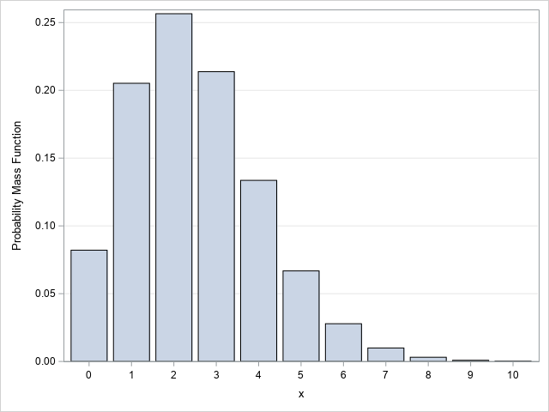


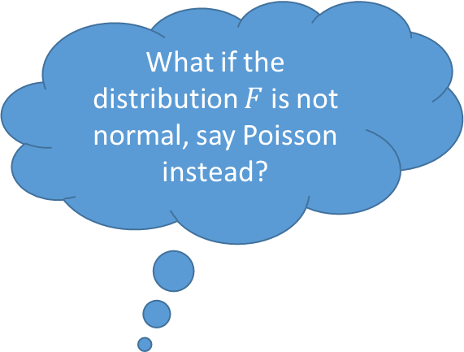
Deviation from Typical Textbook Problem
The central limit theorem states that if you take sufficiently large random samples from the population with replacement, then the sample means will asymptotically follow a normal distribution.
What if the distribution $F$ is not normal, say Poisson instead?
The Central Limit Theorem asserts that the sample mean will distribute asymptotically as a Normal distribution although the probability distribution F is not Normal.

Slide 7
Deviation from Typical Textbook Problem
What if the statistic is the median, the standard deviation, or the range?
What if my sample is not that big, say, n = 10?
What if the distribution F is multivariate and the statistic is the Pearson correlation coefficient?

Slide 8
A Hypothetical Approach
If we can …
Have full access to the original population
Then we can …
Produce a histogram of the array of these statistics
Compute the statistic $s_{k}\left(X\right)$, where $k=1, 2, …$ are indices to the draws
Compute the statistic 𝑠_𝑘 (𝐗), where 𝑘=1, 2, … are indices to the draws
Repeatedly draw a random sample of size n from the original population
Calculate the standard deviation of these statistics
Determine an interval which covers 95% of these statistics

Slide 9
Reality is …
The original population cannot be directly observed
We may not locate all patients who had a deadly disease but were not diagnosed.
Some of them may have passed away due to the disease.
We cannot accurately calculate the mortality rate of the disease.
It is logistically infeasible to observe the original population
Not everyone U.S. citizens who earn income live in the States.
The U.S. Census may not able to contact every U.S. citizens.
Thus, we cannot accurately calculate the U.S. Median Income

Slide 10
Resampling is the Solution
The sample carries the genes of the population because they are from the population
Pretend the sample is the population, draw with replacement from this make-believe population to create another sample that represents the population
Thus simulate as many “samples” as we can handle from the true population
If we can introduce variations into the sample, then we may create another sample that represents the population.

Slide 11
Bootstrap Method
A Brief History
The bootstrap method was first published by Bradley Efron in 1979
Professor of Statistics at Stanford, http://statweb.stanford.edu/~ckirby/brad/
Bootstrap Methods: Another Look At The Jackknife, The Annals of Statistics, 1979, Volume 7, Number 1, Pages 1-26
The Jackknife, the Bootstrap and Other Resampling Plans, 1982, Society for Industrial and Applied Mathematics (SIAM), U.S.
An Introduction to the Bootstrap, 1993, Chapman & Hall, co-authored with R.J. Tibshirani (also at Stanford)

Slide 12
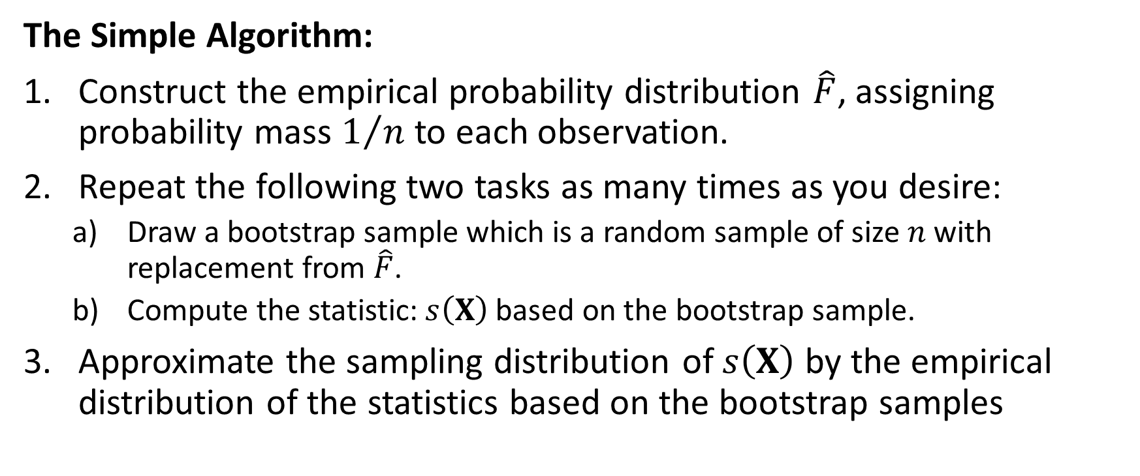
Bootstrap Method
The Simple Algorithm:
Construct the empirical probability distribution $\hat{F}$, assigning probability mass $1/n$ to each observation.
Repeat the following two tasks as many times as you desire:
Draw a bootstrap sample which is a random sample of size $n$with replacement from $\hat{F}$.
Compute the statistic: $s\left(X\right)$ based on the bootstrap sample.
Approximate the sampling distribution of $s\left(X\right)$ by the empirical distribution of the statistics based on the bootstrap samples

Slide 13
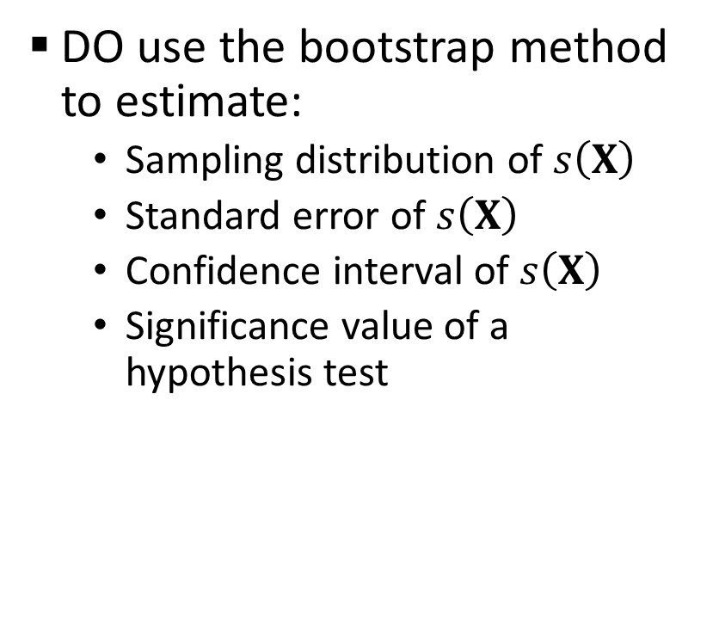
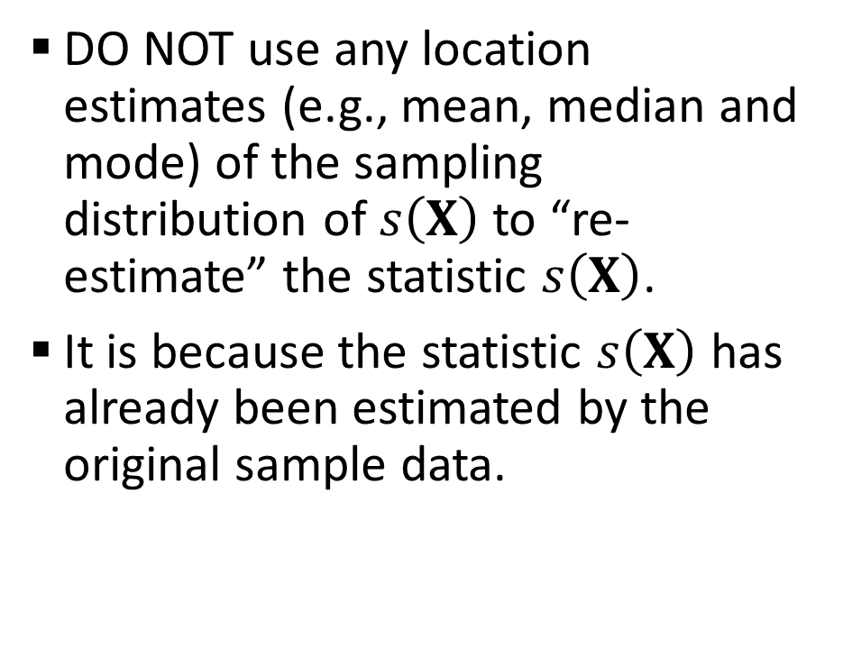
In the Original Theory …
DO use the bootstrap method to estimate:
Sampling distribution of $s\left(X\right)$
Standard error of $s\left(X\right)$
Confidence interval of $s\left(X\right)$
Significance value of a hypothesis test
DO NOT use any location estimates (e.g., mean, median and mode) of the sampling distribution of $s\left(X\right)$ to “re-estimate” the statistic $s\left(X\right)$.
It is because the statistic $s\left(X\right)$ has already been estimated by the original sample data.

Slide 14

Bootstrap Method
Sampling With Replacement Using Python:
def sample_wr (inData):
n = len(inData)
outData = numpy.empty((n,1))
for i in range(n):
j = int(random.random() * n)
outData[i] = inData[j]
return outData
The bootstrap sample should have the same number of observations $n$ as the original sample.
Draw a random integer $j$ between 0 and $n−1$.
Pull the $j$^{th} observation from the original sample into the bootstrap sample.
1
2
3

Slide 15
Bootstrap Method
import numpy
import random
# Create a bootstrap sample from the population
def sample_wr (inData):
n = len(inData)
outData = numpy.empty((n,1))
for i in range(n):
j = int(random.random() * n)
outData[i] = inData[j]
return outData
x = numpy.array([1,2,3,4,5,6,7,8,10])
unique, counts = numpy.unique(x, return_counts = True)
print('Original Sample:\n', numpy.asarray((unique, counts)).transpose())
# Check the bootstrap sample
random.seed(20191113)
sample1 = sample_wr(x)
unique, counts = numpy.unique(sample1, return_counts = True)
print('Sample 1:\n', numpy.asarray((unique, counts)).transpose())
sample2 = sample_wr(x)
unique, counts = numpy.unique(sample2, return_counts = True)
print('Sample 2:\n', numpy.asarray((unique, counts)).transpose())
sample3 = sample_wr(x)
unique, counts = numpy.unique(sample3, return_counts = True)
print('Sample 3:\n', numpy.asarray((unique, counts)).transpose())
sample4 = sample_wr(x)
unique, counts = numpy.unique(sample4, return_counts = True)
print('Sample 4:\n', numpy.asarray((unique, counts)).transpose())
Week 13 Create Bootstrap Sample.py

Slide 16
Bootstrap Method
[data value, frequency count]
Original Sample:
[[ 1 1]
[ 2 1]
[ 3 1]
[ 4 1]
[ 5 1]
[ 6 1]
[ 7 1]
[ 8 1]
[10 1]]
Sample 1:
[[ 1. 1.]
[ 2. 2.]
[ 3. 1.]
[ 4. 1.]
[ 7. 1.]
[ 8. 1.]
[10. 2.]]
Sample 2:
[[ 1. 2.]
[ 3. 1.]
[ 4. 1.]
[ 5. 2.]
[ 6. 1.]
[10. 2.]]
Sample 3:
[[1. 1.]
[2. 1.]
[3. 1.]
[4. 2.]
[5. 3.]
[6. 1.]]
Sample 4:
[[ 1. 1.]
[ 2. 2.]
[ 3. 2.]
[ 5. 2.]
[ 6. 1.]
[10. 1.]]

Slide 17
Bootstrap Method
Bootstrapping Using Python:
In each bootstrap iteration:
Create a bootstrap sample
Calculate the statistic of interest accordingly
Append the statistic of interest to a dataset
Derive the summary on the statistic of interest
Generate the empirical distribution
Find a pair of values that enclose 95% of values
Calculate the standard deviation of values

Slide 18
Bootstrap Method: Mean Examples
Common Specifications
Input Data
Number of observations is 100
Data are simulated from a particular distribution
Random seed is 20191113
The summary statistic is the Mean
Bootstrapping
Get the standard error and 95% confidence interval of the summary statistic
Perform 500 and 1000 times
random.seed(a = 20191113)
population = numpy.zeros((nPopulation,1))
for i in range(nPopulation):
population[i] = random.gauss(10,7)
zConfInterval (population)
Week 13 Bootstrap Mean Example.py

Slide 19
Bootstrap Method: Mean Examples
# Calculate the means for the bootstrap samples
def bootstrap_mean (inData, nB):
n = len(inData)
outMean = numpy.empty((nB,1))
for iB in range(nB):
bootSample = sample_wr(inData)
bootMean = 0
for j in range(n):
bootMean = bootMean + bootSample[j]
outMean[iB] = bootMean / n
return outMean
Week 13 Bootstrap Mean Example.py
# Calculate the 95% confidence interval based on the normal distribution
def zConfInterval (inData):
n = len(inData)
obsMean = inData.mean()
obsSE = inData.std() / numpy.sqrt(n)
z = 1.9599639845
lowerCI = obsMean - z * obsSE
upperCI = obsMean + z * obsSE
print('Observed Mean: {:.7f}' .format(obsMean))
print('Observed Standard Error: {:.7f}' .format(obsSE))
print('95% z-confidence interval {:.7f}, {:.7f}:' .format(lowerCI, upperCI))

Slide 20
Bootstrap Method: Mean Examples
Summarize the bootstrap results to obtain estimates for the statistic’s standard error, 95% confidence interval, and sample distribution
# Summarize the bootstrap results
def summarize_bootstrap (bootResult):
print('Bootstrap Statistics:\n')
print(' Number:', len(bootResult))
print(' Mean: {:.7f}' .format(bootResult.mean()))
print(' Standard Deviation: {:.7f}' .format(bootResult.std()))
print('95% Confidence Interval: {:.7f}, {:.7f}'
.format(numpy.percentile(bootResult, (2.5)), numpy.percentile(bootResult, (97.5))))
plt.hist(bootResult, align = 'mid', bins = 50)
plt.grid(axis='both')
plt.show()
Week 13 Bootstrap Mean Example.py

Slide 21
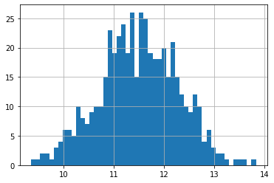
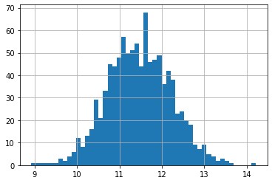
Bootstrap Method: Mean Example 1
Input Data
Simulated Distribution: Normal, mean = 10, standard deviation = 7
Observed Mean ( z-Standard Error) is 11.4698122 ( 0.7502696)
95% z-Confidence Interval is (9.9993108, 12.9403136)
Bootstrapping 500 Times of the Mean Statistic
Mean is 11.4909977 and Standard Deviation is 0.7785430
95% Confidence Interval is (9.9347357, 12.9175503)
Bootstrapping 1000 Times of the Mean Statistic
Mean is 11.4699720 and Standard Deviation is 0.7517242
95% Confidence Interval is (10.0187111, 12.9595051)

Slide 22
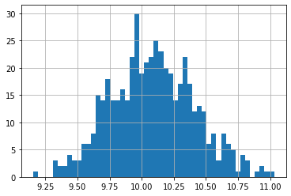
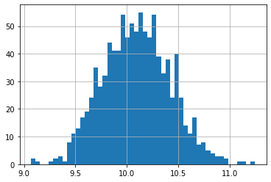
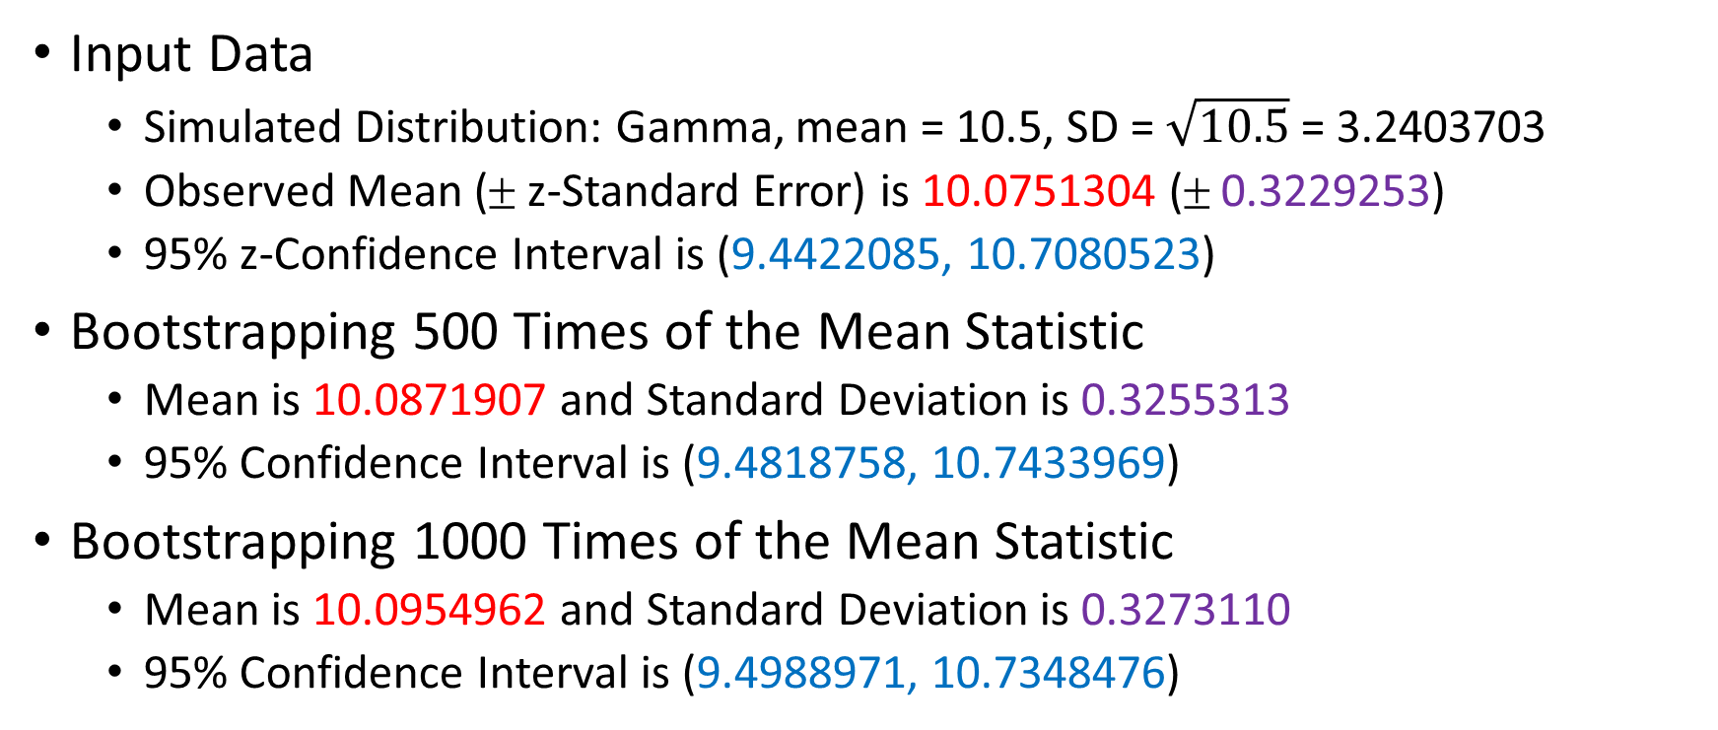
Bootstrap Method: Mean Example 2
Input Data
Simulated Distribution: Gamma, mean = 10.5, SD = $\sqrt{10.5}$ = 3.2403703
Observed Mean ( z-Standard Error) is 10.0751304 ( 0.3229253)
95% z-Confidence Interval is (9.4422085, 10.7080523)
Bootstrapping 500 Times of the Mean Statistic
Mean is 10.0871907 and Standard Deviation is 0.3255313
95% Confidence Interval is (9.4818758, 10.7433969)
Bootstrapping 1000 Times of the Mean Statistic
Mean is 10.0954962 and Standard Deviation is 0.3273110
95% Confidence Interval is (9.4988971, 10.7348476)

Slide 23
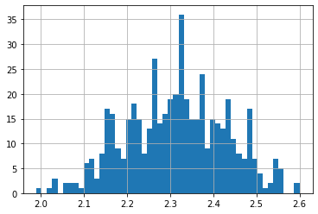
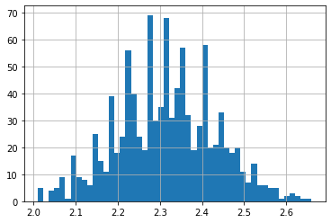
Bootstrap Method: Mean Example 3
Input Data
Simulated Distribution: Pr(X=1)=0.3, Pr(X=2)=0.1, Pr(X=3)=0.4, Pr(X=4)=0.2
E(X) = 2.5, Var(X) = 1.25, SD(X) = 1.1180340
Observed Mean ( z-Standard Error) is 2.3100000 ( 0.1172135)
95% z-Confidence Interval is (2.0802658, 2.5397342)
Bootstrapping 500 Times of the Mean Statistic
Mean is 2.3136800 and Standard Deviation is 0.1157310
95% Confidence Interval is (2.1000000, 2.5400000)
Bootstrapping 1000 Times of the Mean Statistic
Mean is 2.3146500 and Standard Deviation is 0.1168857
95% Confidence Interval is (2.0900000, 2.5500000)

Slide 24
Bootstrap Method: CV Examples
Common Specifications
Input Data
Number of observations is 100
Data are simulated from a particular distribution
Random seed is 20191113
The summary statistic is the Coefficient of Variation = SD / Mean (Note: this is a biased estimator of the population CV)
Bootstrapping
Get the standard error and 95% confidence interval of the summary statistic
500 and 1000 times
Week 14 Bootstrap CV Example.py

Slide 25
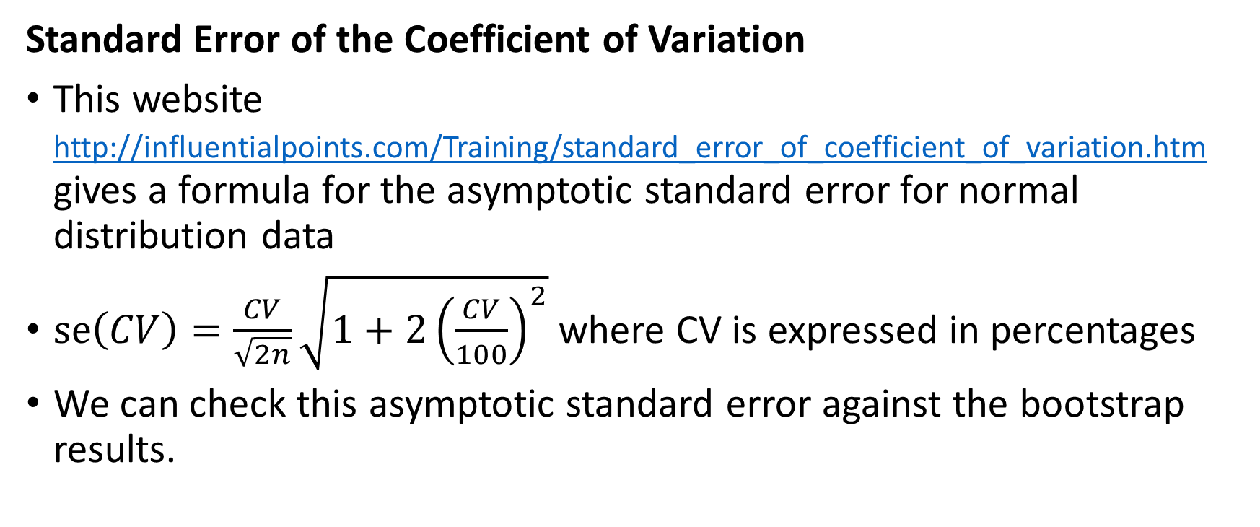
Bootstrap Method: CV Examples
Standard Error of the Coefficient of Variation
This website http://influentialpoints.com/Training/standard_error_of_coefficient_of_variation.htm gives a formula for the asymptotic standard error for normal distribution data
$se\left(CV\right)=\frac{CV}{\sqrt{2n}}\sqrt{1+2{\left(\frac{CV}{100}\right)}^{2}}$where CV is expressed in percentages
We can check this asymptotic standard error against the bootstrap results.
Week 14 Bootstrap CV Example.py

Slide 26
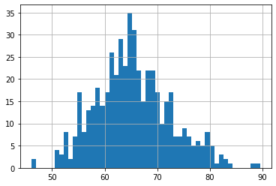
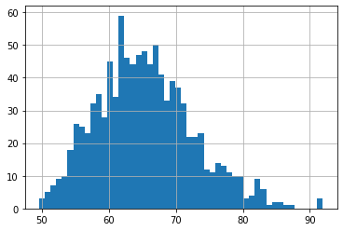
Bootstrap Method: CV Example 1
Input Data
Simulated Distribution: Normal, mean = 10, standard deviation = 7, CV = 70%
Observed CV ( z-Standard Error) is 65.4125456% ( 6.3009638%)
95% z-Confidence Interval is (53.0628835%, 77.7622077%)
Bootstrapping 500 Times of the CV Statistic
Mean is 65.3862739% and Standard Deviation is 7.0765185%
95% Confidence Interval is (52.5474446%, 80.3672691%)
Bootstrapping 1000 Times of the CV Statistic
Mean is 65.4251694% and Standard Deviation is 7.2087710%
95% Confidence Interval is (53.1530442%, 81.6593212%)

Slide 27
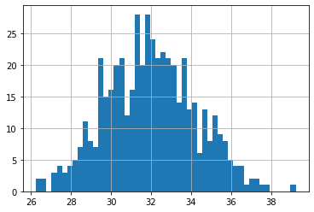
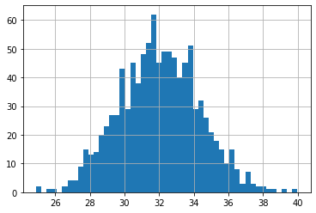
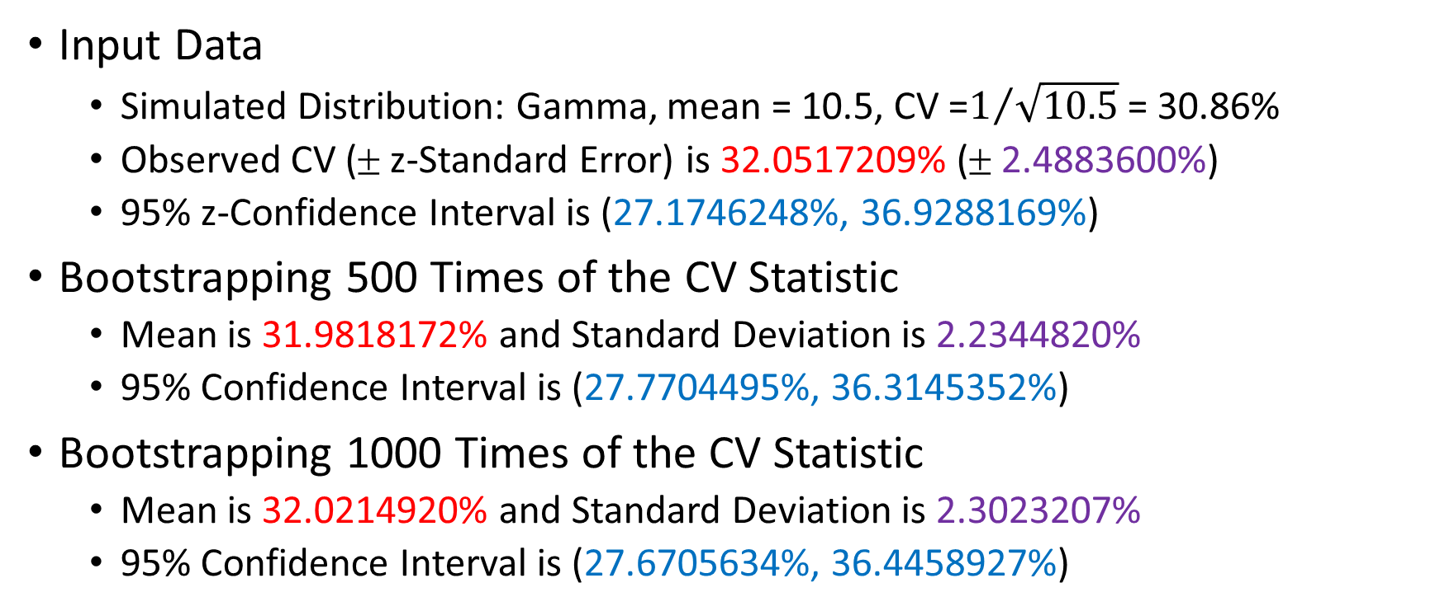
Bootstrap Method: CV Example 2
Input Data
Simulated Distribution: Gamma, mean = 10.5, CV =$1/{\sqrt{10.5}}$ = 30.86%
Observed CV ( z-Standard Error) is 32.0517209% ( 2.4883600%)
95% z-Confidence Interval is (27.1746248%, 36.9288169%)
Bootstrapping 500 Times of the CV Statistic
Mean is 31.9818172% and Standard Deviation is 2.2344820%
95% Confidence Interval is (27.7704495%, 36.3145352%)
Bootstrapping 1000 Times of the CV Statistic
Mean is 32.0214920% and Standard Deviation is 2.3023207%
95% Confidence Interval is (27.6705634%, 36.4458927%)

Slide 28
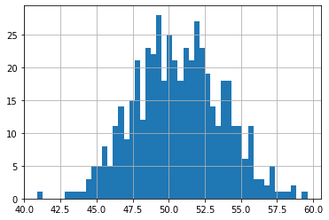
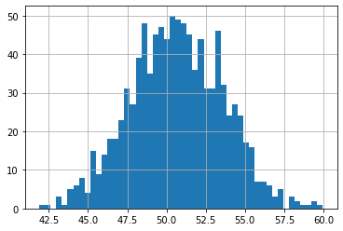
Bootstrap Method: CV Example 3
Input Data
Simulated Distribution: Pr(X=1)=0.3, Pr(X=2)=0.1, Pr(X=3)=0.4, Pr(X=4)=0.2
E(X) = 2.5, Var(X) = 1.25, theoretical CV is 44.72%
Observed CV ( z-Standard Error) is 50.7417664% ( 4.4162034%)
95% z-Confidence Interval is (42.0861668%, 59.3973661%)
Bootstrapping 500 Times of the CV Statistic
Mean is 50.6918017% and Standard Deviation is 3.0381406%
95% Confidence Interval is (44.9900869%, 56.5142718%)
Bootstrapping 1000 Times of the CV Statistic
Mean is 50.6632044% and Standard Deviation is 2.9507101%
95% Confidence Interval is (44.7786547%, 56.2430608%)

Slide 29
Bootstrap Method
Closing Remarks:
The Confidence Interval is simple to use, but actual probability coverage may be less than the nominal value, e.g., 95%.
The bootstrap method depends on the sample being representative. Otherwise, the re-sampling results will be inappropriate.
If the sample statistic of interest (e.g., the Coefficient of Variation) is already a biased estimate of the population statistic, then the bootstrap method cannot correct the problem though the bootstrap standard error and confidence interval are accurate

Slide 30
Ensemble Learners
The idea is to train a series of models using the same learning algorithm.
The objective is to combine the models and create a stronger model that delivers better performance.
Bagging averages a series of model outcomes which have high variance to decrease the outcome variance.
Boosting builds a series of incremental models to decrease the bias, while keeping variance small.

Slide 31
Bagging or Boosting: Overview
Select a supervised learner algorithm that meet your business specifications
Train the algorithm multiple times
Bagging: In parallel on different training samples
Boosting: Sequentially with different weights on observations
Assemble the predictions from the models, with or without weights
The ensemble prediction is the outcome of the Ensemble Method

Slide 32
Bagging
Bagging is Bootstrap Aggregating:
Create a bootstrap sample from the training partition
The model is trained individually on each bootstrap sample
Observations in a bootstrap sample are not weighted
Models’ predicted target values are summarized (without weights) to produce the ensemble prediction
Mean of the predicted values for an interval target
Mean of the predicted probabilities for a category of a categorical target
Mode of the predicted outcome of a categorical target (majority vote)

Slide 33
Bagging Example: HMEQ
Interval predictors: DELINQ and DEBTINC
Binary target: BAD (1 = Event, 0 = Non-Event)
5960 observations read
4,217 observations used after removing missing values in the predictors and the target variable
Assign the observations into the Training and the Testing partitions, stratified by the target variable
70% for Training, actually has 2,951 observations
30% for Testing, actually has 1,266 observations
Week 13 Bagging ClassTree Example.py

Slide 34
Bagging Example: HMEQ
Classification of Observations
Classify an observation as an Event if the predicted probability is greater than or equal to a threshold value
The threshold is the fraction of BAD = 1 observations in the Training partition
The threshold value is 0.09115554049474754
Classification Tree Specifications
Criterion is Entropy
Maximum depth is two (i.e., the tree has three layers including the root node)
Random seed is 60616

Slide 35
Bagging Example: HMEQ
hmeq = pandas.read_csv('C:\\IIT\\Machine Learning\\Data\\hmeq.csv',
usecols = ['DELINQ', 'DEBTINC', 'BAD'])
hmeq = hmeq.dropna()
# Partition the data, 70% for training and 30% for testing
x_train, x_test, y_train, y_test = model_selection.train_test_split(hmeq[['DELINQ', 'DEBTINC’]],
hmeq[['BAD']], test_size = 0.3, random_state = 20191113, stratify = hmeq[['BAD']])
# Calculate the threshold value for declaring a predicted event
threshold = len(y_train[y_train['BAD'] == 1]) / len(y_train)
print('Threshold Value for Declaring a Predicted Event = {:.7f}' .format(threshold))
# Build a classification tree on the training partition
classTree = tree.DecisionTreeClassifier(criterion='entropy', max_depth=2, random_state=60616)
treeFit = classTree.fit(x_train, y_train['BAD'])
treePredProb = classTree.predict_proba(x_test)
AUC_test, RASE_test, MisClassRate_test = ModelMetrics (y_test['BAD'].values, 1, treePredProb[:,1],
threshold)

Slide 36
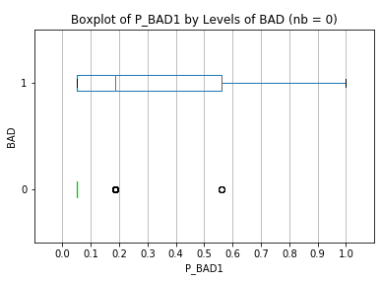
Bagging Example: HMEQ
Classification Tree Without Bagging:
Metrics are calculated on the Testing partition
Area Under Curve = 0.7097004
Misclassification Rate = 0.1895735
Root Average Squared Error = 0.2500173
Comments
The classification tree result is fairly good
Can we improve further?

Slide 37
Bagging Example: HMEQ
Classification Tree With Bagging:
def bootstrap_classTree (x_train, y_train, x_test, nB):
x_index = x_train.index
nT = len(x_test)
outProb = numpy.zeros((nT,2))
classTree = tree.DecisionTreeClassifier(criterion='entropy', max_depth=2, random_state=60616)
random.seed(20181114)
for iB in range(nB):
bootIndex = sample_wr(x_index)
x_train_boot = x_train.loc[bootIndex[:,0]]
y_train_boot = y_train.loc[bootIndex[:,0]]
treeFit = classTree.fit(x_train_boot, y_train_boot['BAD'])
outProb = outProb + classTree.predict_proba(x_test)
outProb = outProb / nB
return outProb

Slide 38
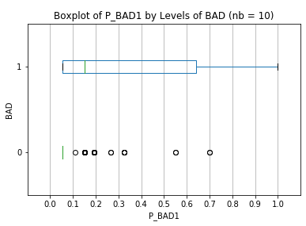
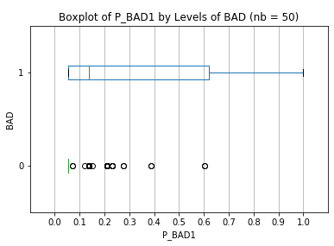

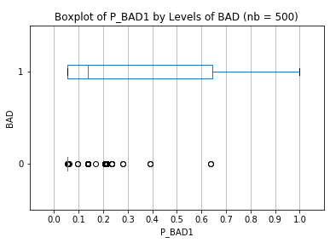
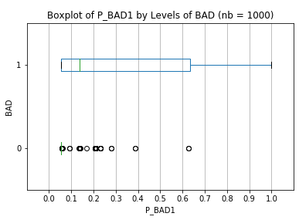
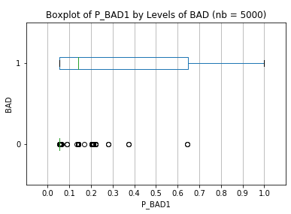
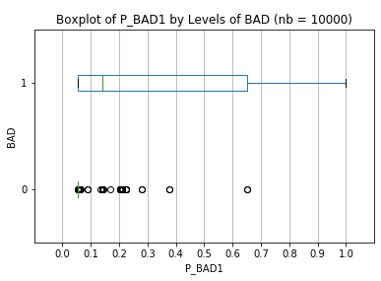
Bagging Example: HMEQ
Median for BAD=1 gets smaller
Points for BAD = 0 spread further apart

Slide 39
Bagging Example: HMEQ
Number of Bootstraps | Area Under Curve | Misclassification Rate | Root Average Squared Error
0 (No Bagging) | 0.7097004 | 0.1895735 | 0.2500173
10 | 0.7245798 | 0.1919431 | 0.2479301
50 | 0.7238772 | 0.1919431 | 0.2465820
100 | 0.7249537 | 0.1935229 | 0.2466624
500 | 0.7251426 | 0.1935229 | 0.2465695
1000 | 0.7313980 | 0.1927330 | 0.2466442
5000 | 0.7282137 | 0.1919431 | 0.2466952
10000 | 0.7282137 | 0.1919431 | 0.2467116

Slide 40
Bagging in Python
You can, of course, implement your own Bagging function
Python offers efficient ways to perform Bagging
sklearn.ensemble.BaggingClassifier
sklearn.ensemble.BaggingRegressor

Slide 41
Bagging in Python
nB = 10000
classTree = tree.DecisionTreeClassifier(criterion='entropy', max_depth=2, random_state=60616)
bagTree = ensemble.BaggingClassifier(base_estimator = classTree, n_estimators = nB, random_state = 20191113, verbose = 1)
bagFit = bagTree.fit(x_train, y_train['BAD'])
bagPredProb = bagFit.predict_proba(x_test)
AUC_test, RASE_test, MisClassRate_test = ModelMetrics (y_test['BAD'].values, 1, bagPredProb[:,1], threshold)
y_test['P_BAD1'] = treePredProb[:,1]
y_test.boxplot(column='P_BAD1', by='BAD', vert = False, figsize=(6,4))
plt.title("Boxplot of P_BAD1 by Levels of BAD (nb = " + str(nB) + ')')
plt.suptitle(" ")
plt.xlabel("P_BAD1")
plt.ylabel("BAD")
plt.xlim(-0.1,1.1)
plt.grid(axis="y")
plt.xticks(numpy.arange(0.0, 1.1, 0.1))
plt.show()
print(' Number of Bootstraps: ', nB)
print(' Area Under Curve: {:.7f}' .format(AUC_test))
print(' Misclassification Rate: {:.7f}' .format(MisClassRate_test))
print('Root Average Squared Error: {:.7f}' .format(RASE_test))

Slide 42

Bagging in Python
ensemble.BaggingClassifier
Number of Bootstraps: 10000
Area Under Curve: 0.7228233
Misclassification Rate: 0.1919431
Root Average Squared Error: 0.2467374
Faster
Home-grown Bagging
Number of Bootstraps: 10000
Area Under Curve: 0.7282137
Misclassification Rate: 0.1919431
Root Average Squared Error: 0.2467116
Slower but Flexible

Slide 43
Bagging Example: HMEQ
We use the Bootstrap method to estimate the distribution of the predicted probabilities Prob(BAD = 0) and Prob(BAD = 1).
The more bootstrap iterations performed, the distributions will be more precise (a layman term for the word Converged).
Indirectly, the Area Under Curve, the Misclassification Rate, and the Root Average Squared Error metrics will be more precise for large enough number of bootstrap iterations.

Slide 44

Bagging: Number of Bootstrap Samples
Not Necessary, it depends on the metrics that you used. But you get more precise results.
Will getting more bootstrap samples give me a better model?

Slide 45
Bagging: Should I Do It?
Implementation of Bagging is straightforward
Bagging can be applied to any supervised predictive models
Bagging will, in general, improve model goodness-of-fit, but for a price of model interpretation
Because the bagging builds the same model on multiple training data
Then aggregates the multiple outcomes (e.g., predicted probabilities).
Bagging will consume more machine computing cycles and resources
Specify your number of bootstrap samples based on how long you can wait for the results.

Slide 46
Adaptive Boosting (AdaBoost)
Boosting adaptively weighs observations:
The model is trained on the training partition (without weights)
Poorly predicted observations are assigned larger weights, such that subsequent model will try to improve their prediction accuracies
Iterate Step 2 until the overall model performance is desirable
Outcomes from the models (e.g., predicted probabilities) are aggregated with weights to produce the ensemble prediction
A model with poor model performance is given less weight
A model with good model performance is given more weight

Slide 47
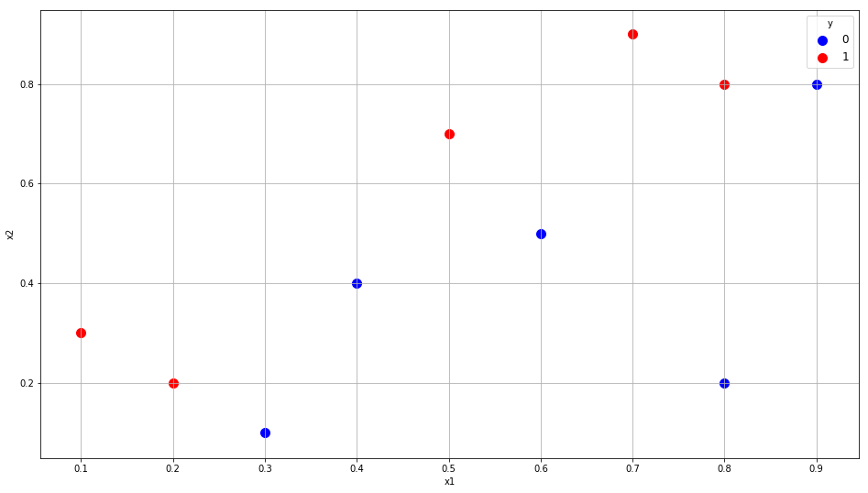
Boosting: Toy Example
Ten observations
Two interval predictors X1 and X2
One binary target Y (1 = Event, 0 = Non-Event)
Index | x1 | x2 | y
0 | 0.1 | 0.3 | 1
1 | 0.2 | 0.2 | 1
2 | 0.3 | 0.1 | 0
3 | 0.4 | 0.4 | 0
4 | 0.5 | 0.7 | 1
5 | 0.6 | 0.5 | 0
6 | 0.7 | 0.9 | 1
7 | 0.8 | 0.8 | 1
8 | 0.8 | 0.2 | 0
9 | 0.9 | 0.8 | 0
Week 13 Toy AdaBoost Example.py

Slide 48
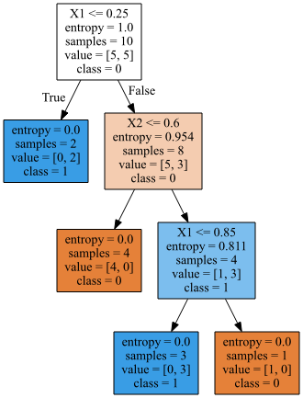
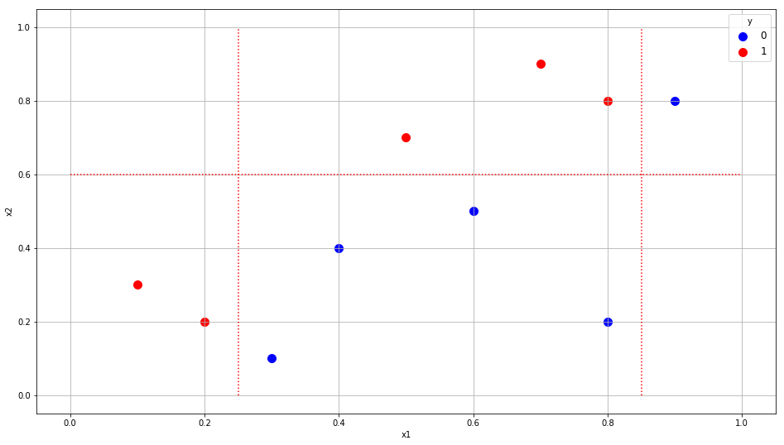
Boosting: A Strong Learner Toy Example
classTree = tree.DecisionTreeClassifier(criterion='entropy', max_depth=10, random_state=60616)
treeFit = classTree.fit(x_train, y_train)
treePredProb = classTree.predict_proba(x_train)
accuracy = classTree.score(x_train, y_train)
Misclassification Rate is 0%

Slide 49
Boosting: A Weak Learner Toy Example
x_train = numpy.array([[0.1, 0.3],
[0.2, 0.2],
[0.3, 0.1],
[0.4, 0.4],
[0.5, 0.7],
[0.6, 0.5],
[0.7, 0.9],
[0.8, 0.8],
[0.8, 0.2],
[0.9, 0.8]], dtype = float)
y_train = numpy.array([1, 1, 0, 0, 1, 0, 1, 1, 0, 0], dtype = float)
w_train = numpy.array([1, 1, 1, 1, 1, 1, 1, 1, 1, 1], dtype = float)
classTree = tree.DecisionTreeClassifier(criterion='entropy', max_depth=1, random_state=60616)
treeFit = classTree.fit(x_train, y_train, w_train)
treePredProb = classTree.predict_proba(x_train)
AUC = metrics.roc_auc_score(y_train, treePredProb[:,1])
print('Area Under Curve = ', AUC)
Suppose the maximum number of depths is restricted to 1

Slide 50
Boosting: Iteration 1
Iteration 1:
eventError = numpy.empty((10, 1))
predClass = numpy.empty((10, 1))
for i in range(10):
if (y_train[i] == 0):
eventError[i] = 0 - treePredProb[i,1]
else:
eventError[i] = 1 - treePredProb[i,1]
if (treePredProb[i,1] >= treePredProb[i,0]):
predClass[i] = 1
else:
predClass[i] = 0
if (predClass[i] != y_train[i]):
w_train[i] = 1 + numpy.abs(eventError[i])
else:
w_train[i] = numpy.abs(eventError[i])
Grow one level deep tree
Score the training data
Weight is 1 + ABS(Error) for misclassified observation, otherwise weight is ABS(Error)
Weighted by Oweight (equals 1 at Iteration 1)

Slide 51
Boosting: Iteration 1
Accuracy = 1 – (3 / 10) = 0.7
CaseID | y | Old Weight | Pr(y=0) | Pr(y=1) | Error | Pred. Class | New Weight
1 | 1 | 1 | 0 | 1 | 0 | 1 | 0
2 | 1 | 1 | 0 | 1 | 0 | 1 | 0
3 | 0 | 1 | 0.625 | 0.375 | -0.375 | 0 | 0.375
4 | 0 | 1 | 0.625 | 0.375 | -0.375 | 0 | 0.375
5 | 1 | 1 | 0.625 | 0.375 | 0.625 | 0 | 1.625
6 | 0 | 1 | 0.625 | 0.375 | -0.375 | 0 | 0.375
7 | 1 | 1 | 0.625 | 0.375 | 0.625 | 0 | 1.625
8 | 1 | 1 | 0.625 | 0.375 | 0.625 | 0 | 1.625
9 | 0 | 1 | 0.625 | 0.375 | -0.375 | 0 | 0.375
10 | 0 | 1 | 0.625 | 0.375 | -0.375 | 0 | 0.375

Slide 52
Boosting: Iteration 2
Accuracy = 1 – (0.375/6.75) = 0.9444444
CaseID | y | Old Weight | Pr(y=0) | Pr(y=1) | Error | Pred. Class | New Weight
1 | 1 | 0 | 1 | 0 | 1 | 0 | 2
2 | 1 | 0 | 1 | 0 | 1 | 0 | 2
3 | 0 | 0.375 | 1 | 0 | 0 | 0 | 0
4 | 0 | 0.375 | 1 | 0 | 0 | 0 | 0
5 | 1 | 1.625 | 0.0714286 | 0.928571 | 0.0714286 | 1 | 0.07142857
6 | 0 | 0.375 | 1 | 0 | 0 | 0 | 0
7 | 1 | 1.625 | 0.0714286 | 0.928571 | 0.0714286 | 1 | 0.07142857
8 | 1 | 1.625 | 0.0714286 | 0.928571 | 0.0714286 | 1 | 0.07142857
9 | 0 | 0.375 | 1 | 0 | 0 | 0 | 0
10 | 0 | 0.375 | 0.0714286 | 0.928571 | -0.928571 | 1 | 1.92857143
Total |  | 6.75

Slide 53
Boosting: Iteration 3
Accuracy = 1 – (0 / 6.1428568) = 1
CaseID | y | Old Weight | Pr(y=0) | Pr(y=1) | Error | Pred. Class | OWeight
1 | 1 | 2 | 0 | 1 | 0 | 1 | 0
2 | 1 | 2 | 0 | 1 | 0 | 1 | 0
3 | 0 | 0 | 0 | 1 | -1 | 1 | 2
4 | 0 | 0 | 0 | 1 | -1 | 1 | 2
5 | 1 | 0.07142857 | 0 | 1 | 0 | 1 | 0
6 | 0 | 0 | 0 | 1 | -1 | 1 | 2
7 | 1 | 0.07142857 | 0 | 1 | 0 | 1 | 0
8 | 1 | 0.07142857 | 0 | 1 | 0 | 1 | 0
9 | 0 | 0 | 0 | 1 | -1 | 1 | 2
10 | 0 | 1.92857143 | 1 | 0 | 0 | 0 | 0

Slide 54
Boosting: Toy Example
Iteration | Ensemble Weight (Accuracy)
1 | 0.7
2 | 0.944444
3 | 1.0
Iteration stops since the Weighted Accuracy has reached 1
Ensemble Prediction:
Boost_P_Y1 = (0.7 * P_Y1_Iteration1 + 0.9444444 * P_Y1_Iteration2 + 1 * P_Y1_Iteration3) / (0.7 + 0.944444 + 1)
Boost_P_Y0 = 1 – Boost_P_Y1

Slide 55
Boosting: Toy Example
caseID | x1 | x2 | y | Boost_P_Y0 | Boost_P_Y1 | Boost_Pred_Y | Misclassify?
1 | 0.1 | 0.3 | 1 | 0.35713 | 0.64287 | 1 | False
2 | 0.2 | 0.2 | 1 | 0.35713 | 0.64287 | 1 | False
3 | 0.3 | 0.1 | 0 | 0.52258 | 0.47742 | 0 | False
4 | 0.4 | 0.4 | 0 | 0.52258 | 0.47742 | 0 | False
5 | 0.5 | 0.7 | 1 | 0.19095 | 0.80905 | 1 | False
6 | 0.6 | 0.5 | 0 | 0.52258 | 0.47742 | 0 | False
7 | 0.7 | 0.9 | 1 | 0.19095 | 0.80905 | 1 | False
8 | 0.8 | 0.8 | 1 | 0.19095 | 0.80905 | 1 | False
9 | 0.8 | 0.2 | 0 | 0.52258 | 0.47742 | 0 | False
10 | 0.9 | 0.8 | 0 | 0.56911 | 0.43089 | 0 | False

Slide 56
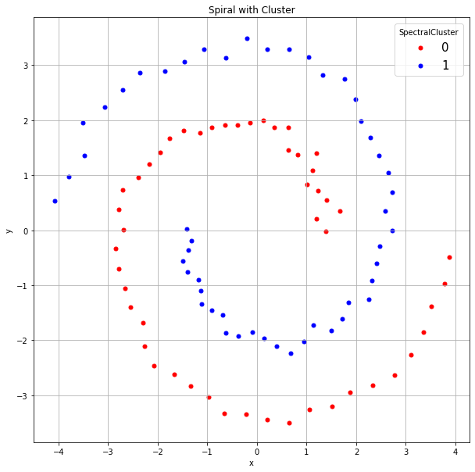
Boosting: Two Spirals
One hundred observations
Two interval predictors x and y
One binary target SpiralCluster (0, 1)
Week 13 Two Spiral AdaBoost.py

Slide 57
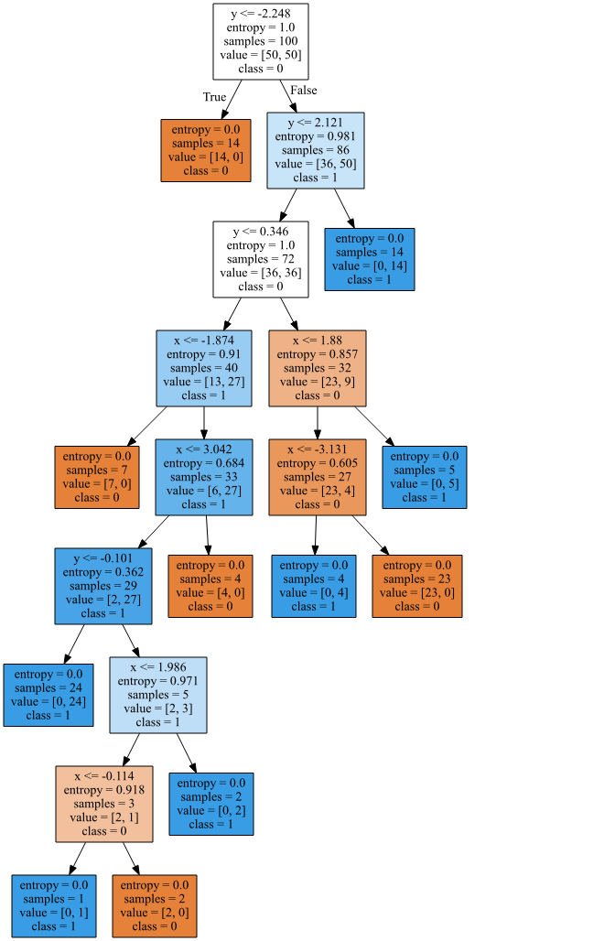
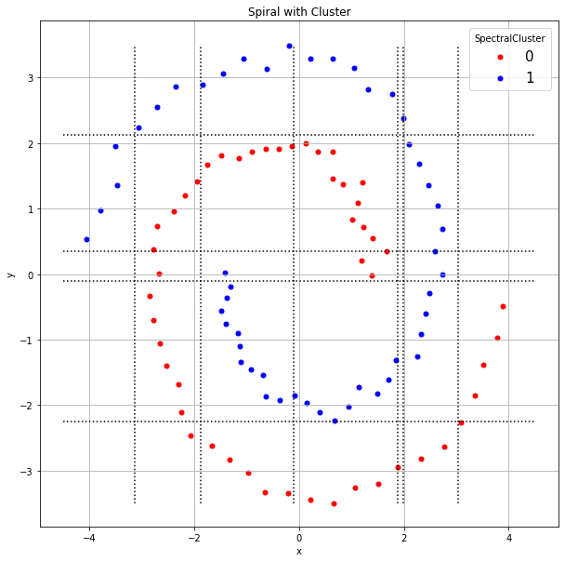
Boosting: A Strong Learner Two Spirals
classTree = tree.DecisionTreeClassifier(criterion='entropy', max_depth=10, random_state=60616)
treeFit = classTree.fit(x_train, y_train)
treePredProb = classTree.predict_proba(x_train)
accuracy = classTree.score(x_train, y_train)
An eight levels tree gives zero Misclassification Rate
The dotted lines indicate the x-coordinate and the y-coordinate of the split criteria

Slide 58
Boosting: A Weak Learner Two Spirals
for iter in range(28):
classTree = tree.DecisionTreeClassifier(criterion='entropy', max_depth=2, random_state=60616)
treeFit = classTree.fit(x_train, y_train, w_train)
treePredProb = classTree.predict_proba(x_train)
accuracy[iter] = classTree.score(x_train, y_train, w_train)
ensemblePredProb += accuracy[iter] * treePredProb
# Update the weights
eventError = numpy.empty((nObs, 1))
predClass = numpy.empty((nObs, 1))
for i in range(nObs):
if (y_train[i] == 0):
eventError[i] = 0 - treePredProb[i,1]
else:
eventError[i] = 1 - treePredProb[i,1]
if (treePredProb[i,1] >= treePredProb[i,0]):
predClass[i] = 1
else:
predClass[i] = 0
if (predClass[i] != y_train[i]):
w_train[i] = 1 + numpy.abs(eventError[i])
else:
w_train[i] = numpy.abs(eventError[i])
Suppose the maximum number of depths is restricted to 2

Slide 59
Boosting: A Weak Learner Two Spirals
Iteration | Accuracy
0 | 0.6400000000000
1 | 0.8819444444444
2 | 0.9784898792124
3 | 0.9874700370451
4 | 0.9936661745293
5 | 0.9979558952939
6 | 0.9987668310317
7 | 0.9995618142112
8 | 0.9997583931071
9 | 0.9999036729736
10 | 0.9999477679093
11 | 0.9999780745323
12 | 0.9999889638162
13 | 0.9999952586201
Iteration | Accuracy
14 | 0.9999976942166
15 | 0.9999989871230
16 | 0.9999994968119
17 | 0.9999997742193
18 | 0.9999998881804
19 | 0.9999999544144
20 | 0.9999999769783
21 | 0.9999999922207
22 | 0.9999999961526
23 | 0.9999999987237
24 | 0.9999999994206
25 | 0.9999999998886
26 | 0.9999999999449
27 | 1.0000000000000
Attained 100% Accuracy in 28 iterations

Slide 60
Boosting: A Weak Learner Two Spirals
# Calculate the final predicted probabilities
ensemblePredProb /= numpy.sum(accuracy)
trainData['predCluster'] = numpy.where(ensemblePredProb[:,1] >= 0.5, 1, 0)
carray = ['red', 'blue']
plt.figure(figsize=(10,10))
for i in range(2):
subData = trainData[trainData['predCluster'] == i]
plt.scatter(x = subData['x'],
y = subData['y'], c = carray[i], label = i, s = 25)
plt.grid(True)
plt.title('Spiral with Cluster')
plt.xlabel('x')
plt.ylabel('y')
plt.legend(title = 'Predicted Cluster', loc = 'best', bbox_to_anchor = (1, 1), fontsize = 15)
plt.show()

Slide 61
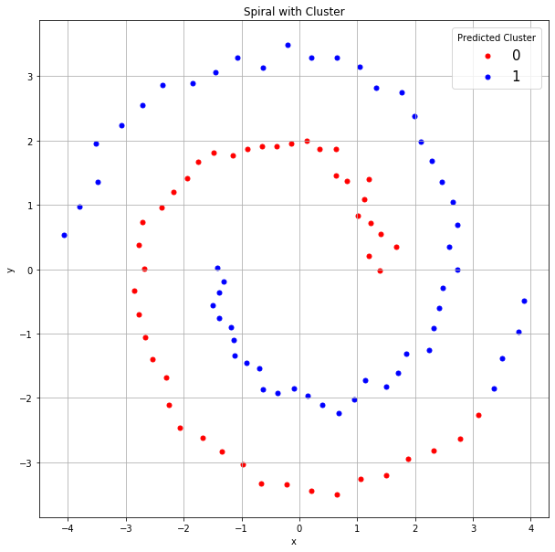
Boosting: A Weak Learner Two Spirals
Except for these four points, our predictions are almost perfect.

Slide 62
Adaptive Boosting in Python
You can, of course, implement your own Adaptive Boosting function
Python offers efficient ways to perform Adaptive Boosting
sklearn.ensemble.AdaBoostClassifier
sklearn.ensemble.AdaBoostRegressor

Slide 63
sklearn.ensemble.AdaBoostClassifier
classTree = tree.DecisionTreeClassifier(criterion='entropy', max_depth=2, random_state=60616)
boostTree = ensemble.AdaBoostClassifier(base_estimator=classTree, n_estimators=28,
learning_rate=1.0, algorithm='SAMME.R', random_state=None)
boostFit = boostTree.fit(x_train, y_train)
boostPredProb = boostFit.predict_proba(x_train)
boostAccuracy = boostFit.score(x_train, y_train)
trainData['predCluster'] = numpy.where(boostPredProb[:,1] >= 0.5, 1, 0)
Ji Zhu, Hui Zou, Saharon Rosset, and Trevor Hastie (2009) "Multi-class AdaBoost", Statistics and Its Interface, Volumne 2, Pages 349-360

Slide 64
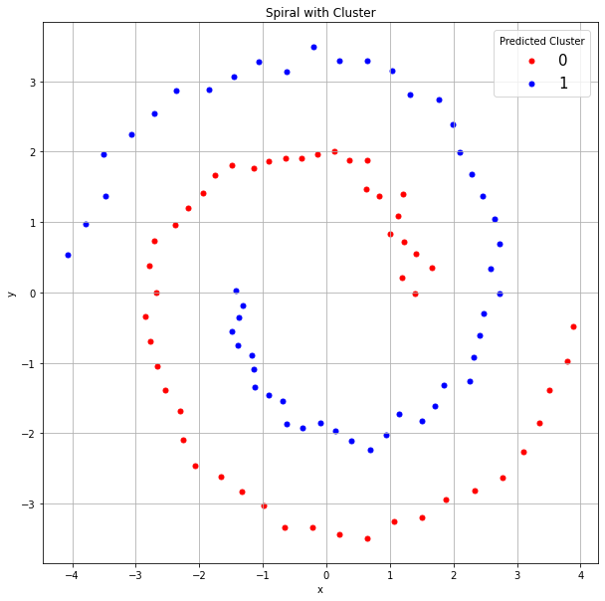
sklearn.ensemble.AdaBoostClassifier
Perfect Predictions!
Choice of Weights Matters

Slide 65
Final Remarks
Likes
Bagging or Boosting often improves model performance
The algorithm is not difficult to implement
Concerns
Since multiple models have been trained (parallelly or sequentially), thus we cannot visually represent all the models altogether (e.g., in a single tree diagram)
The execution time is longer, and special attention needed to avoid a run-away iterative process

Slide 66
Remaining Class Schedule
April 22 | Week 14 Class on Gradient Boosting
April 29 | Individual 15-minute Q&A meeting via Zoom, Google sheet appointment needed
May 3 to May 6 | Take-Home Final Examination, Open on May 3, Deadline on May 6. No Class on May 6

Slide 67

Assignment 5
Due at 11:59 pm on Sunday, May 2, 2021
Submit your answers as a PDF file
Submit your Python codes as .py files, otherwise liable for 50% deduction
No more than two attempts
Only grade the most recently submission

Slide 68
Final Examination
Count 25% toward your final course grade
Online, open-book, open-note format
Work offline until you are ready to enter answers online
Available at 12:01 AM Chicago time on Monday May 3, 2021
Due at 11:59 PM Chicago time on Thursday May 6, 2021
Late submission penalty is 2 points per hour past due

